Slide 1
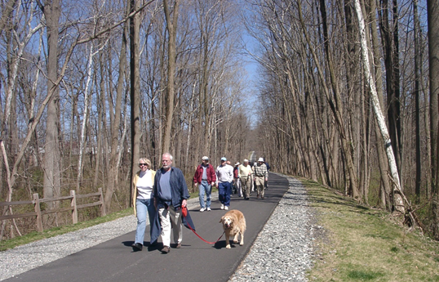
THE
RADNOR TRAIL EXTENSION
Radnor-Chester Rd. to I-476 / Martha Brown Woods
Robert P. Thomas AIA, APBP

Slide 2
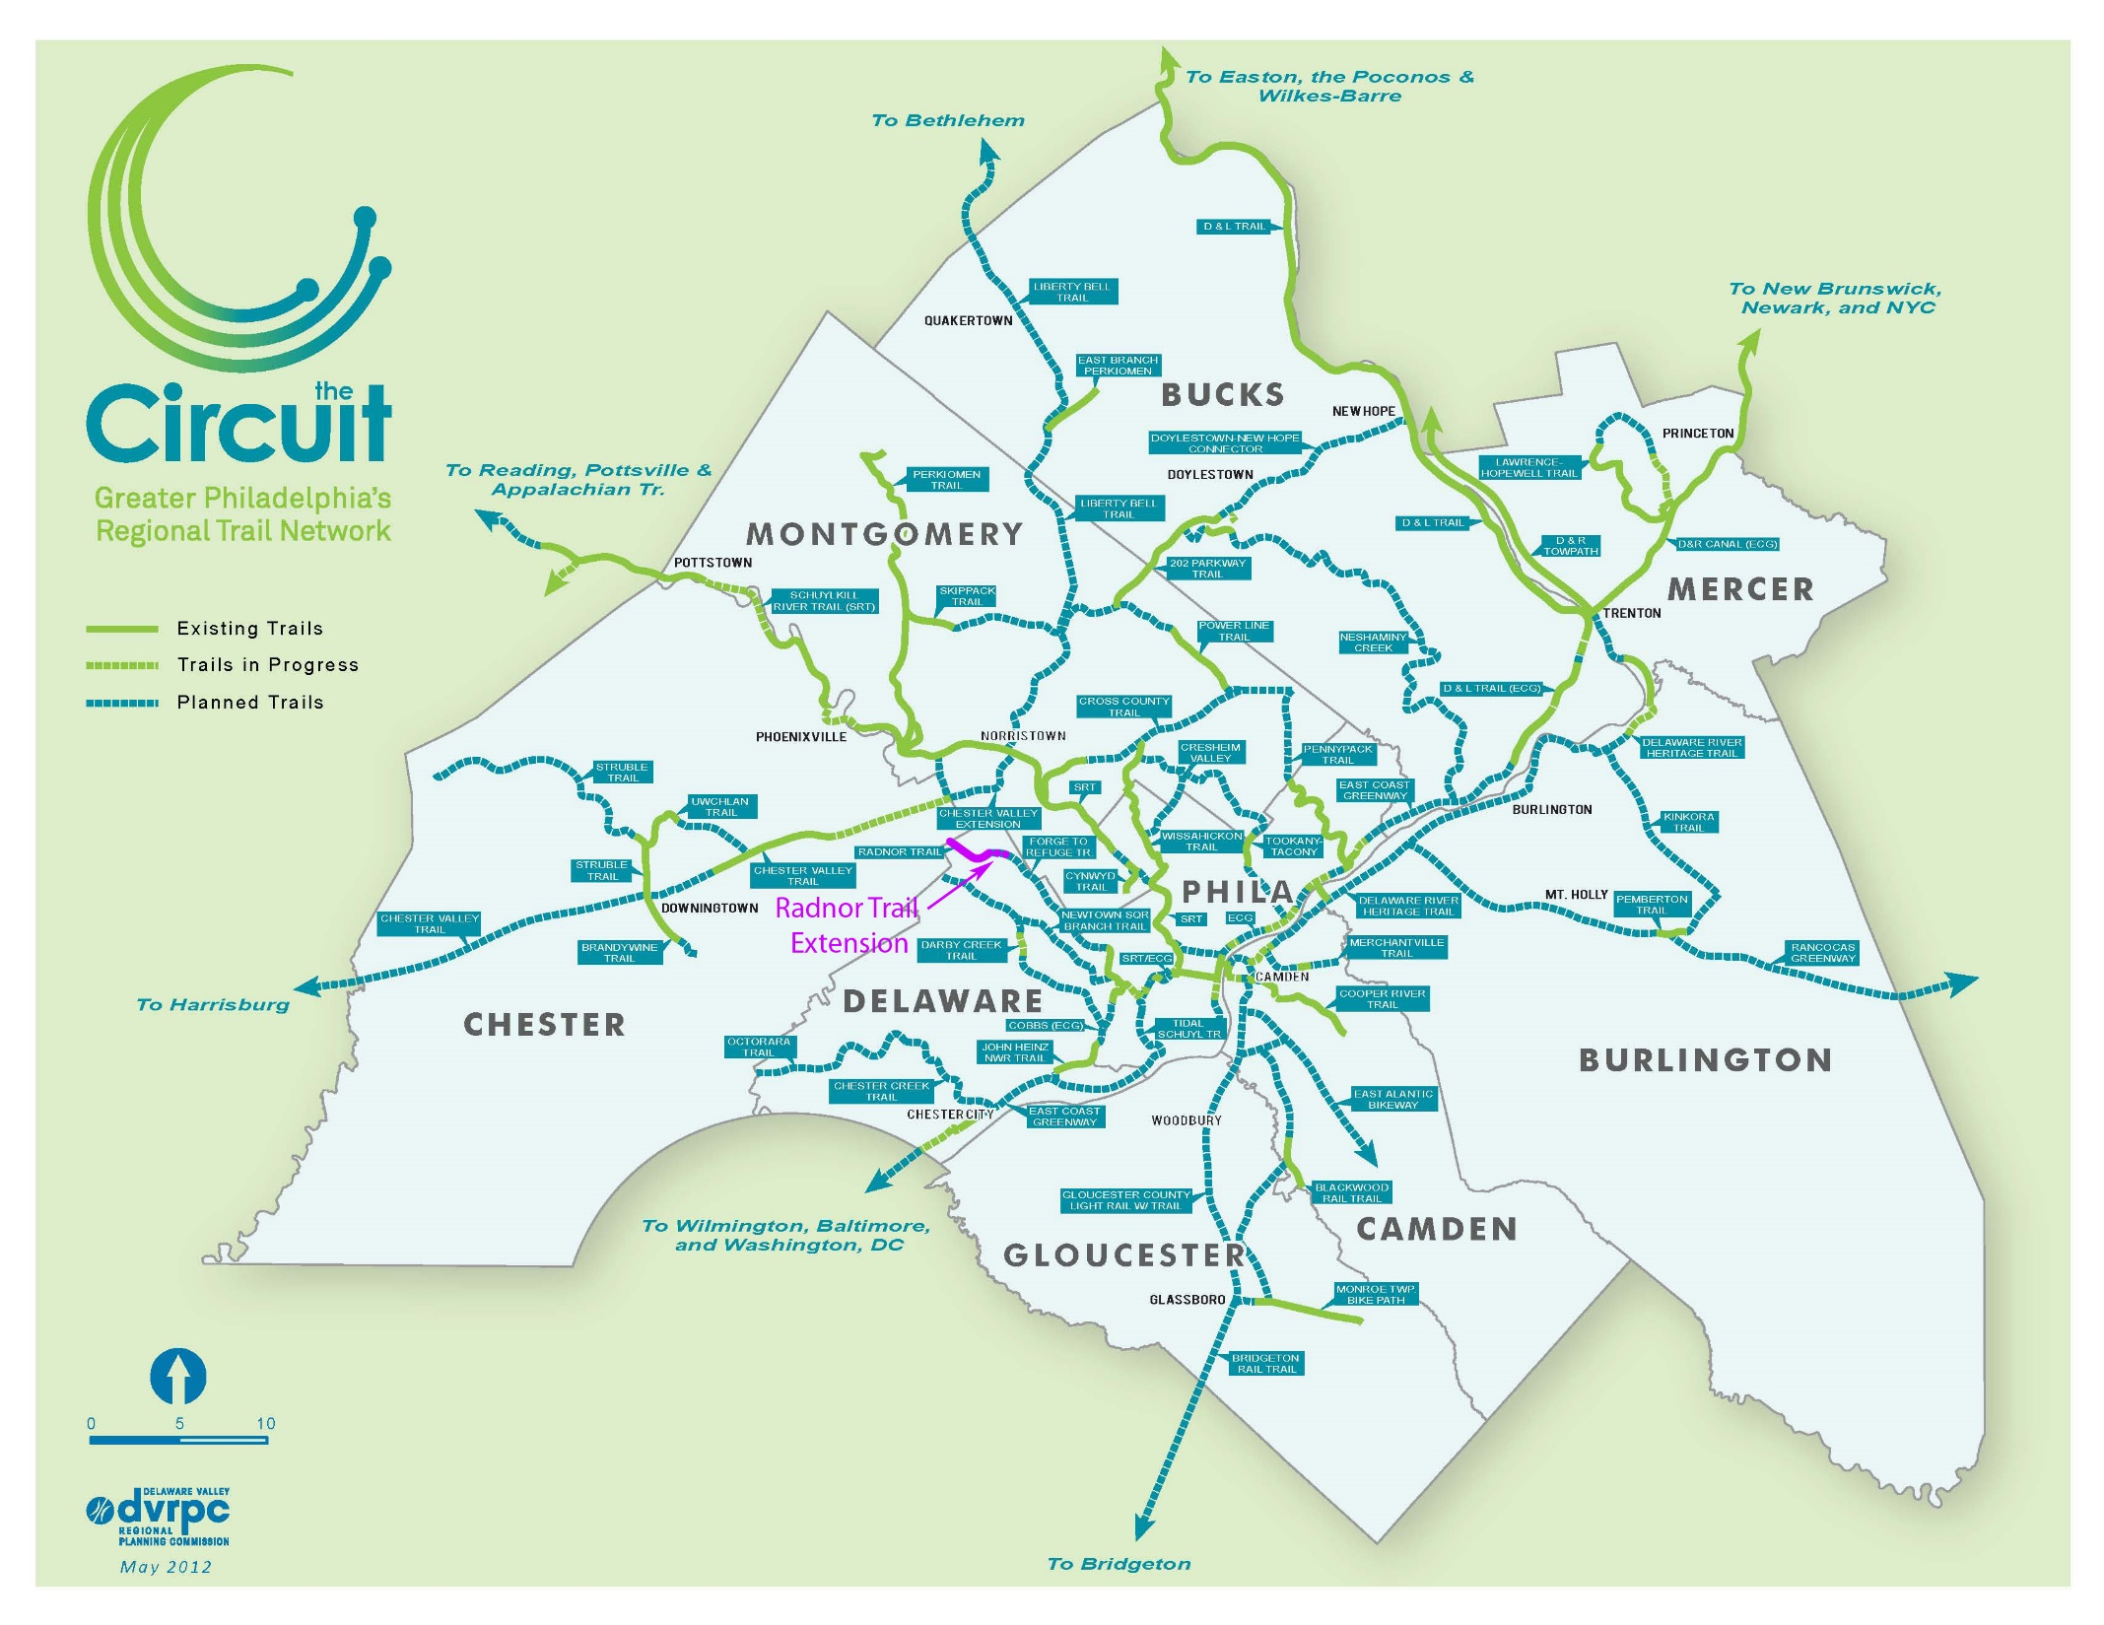

Slide 3
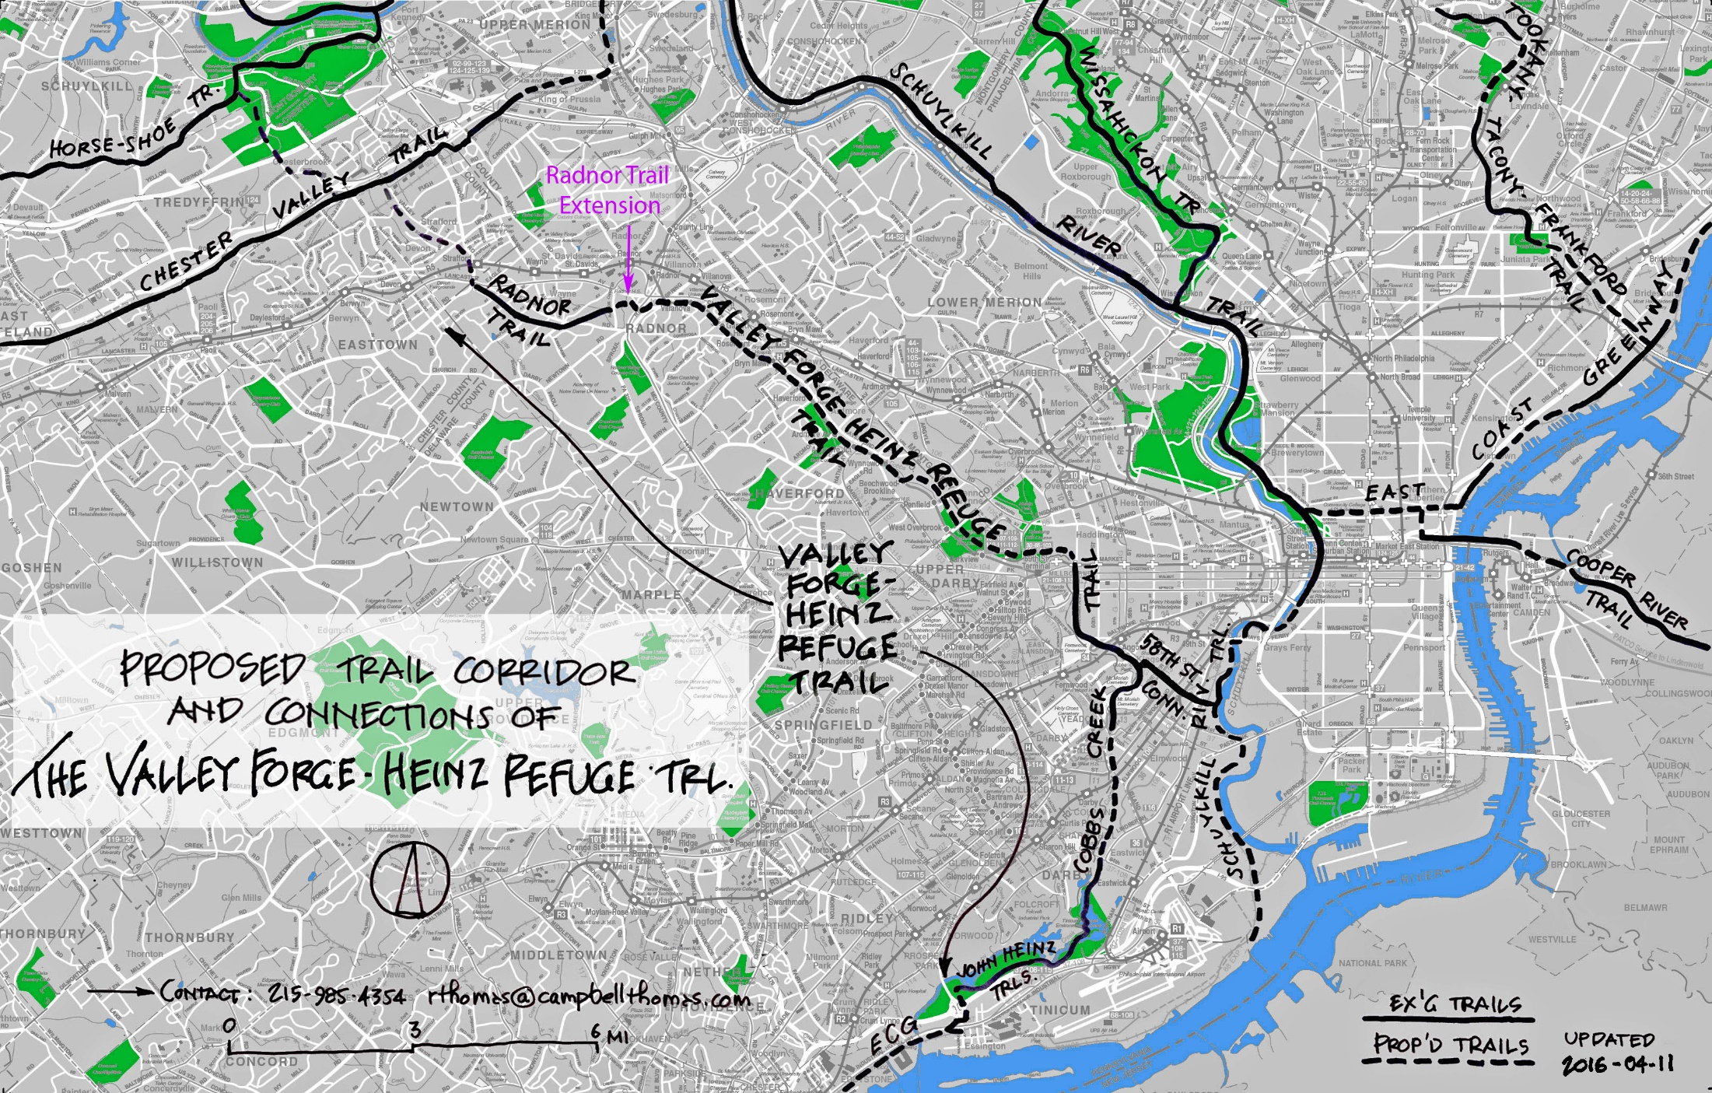
Valley Forge to Heinz Refuge Trail

Slide 4
Project Milestones
Radnor-Chester Road Ramp & Trail Extension Design
Phase II Environmental
E&S Design, Review, and Permit (Completed as part of Initial Contract)
Arsenic Analysis and Report
Trail Extension PS&E Package
PennDOT Final Review
Assistance with Bidding
Construction Phase Services – Trail Ext and Ramp

Slide 5
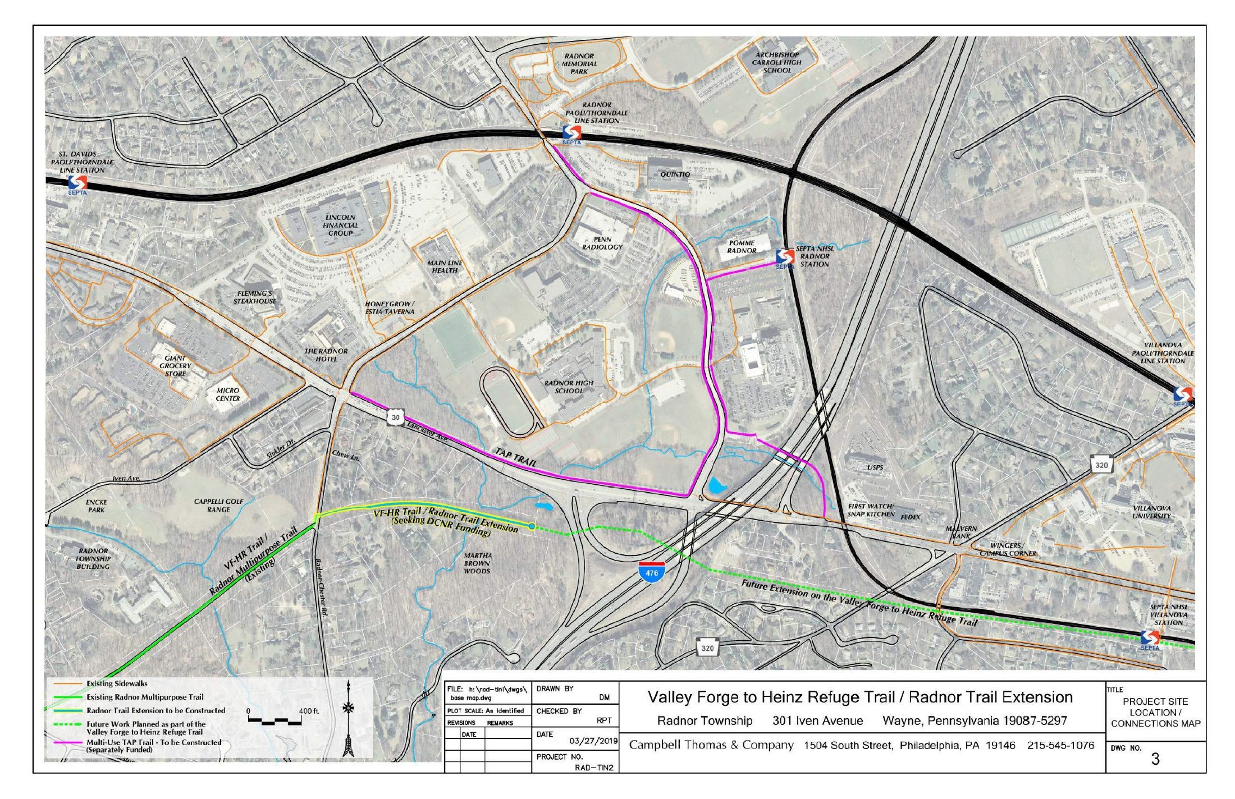
Project Location Map - 1

Slide 6
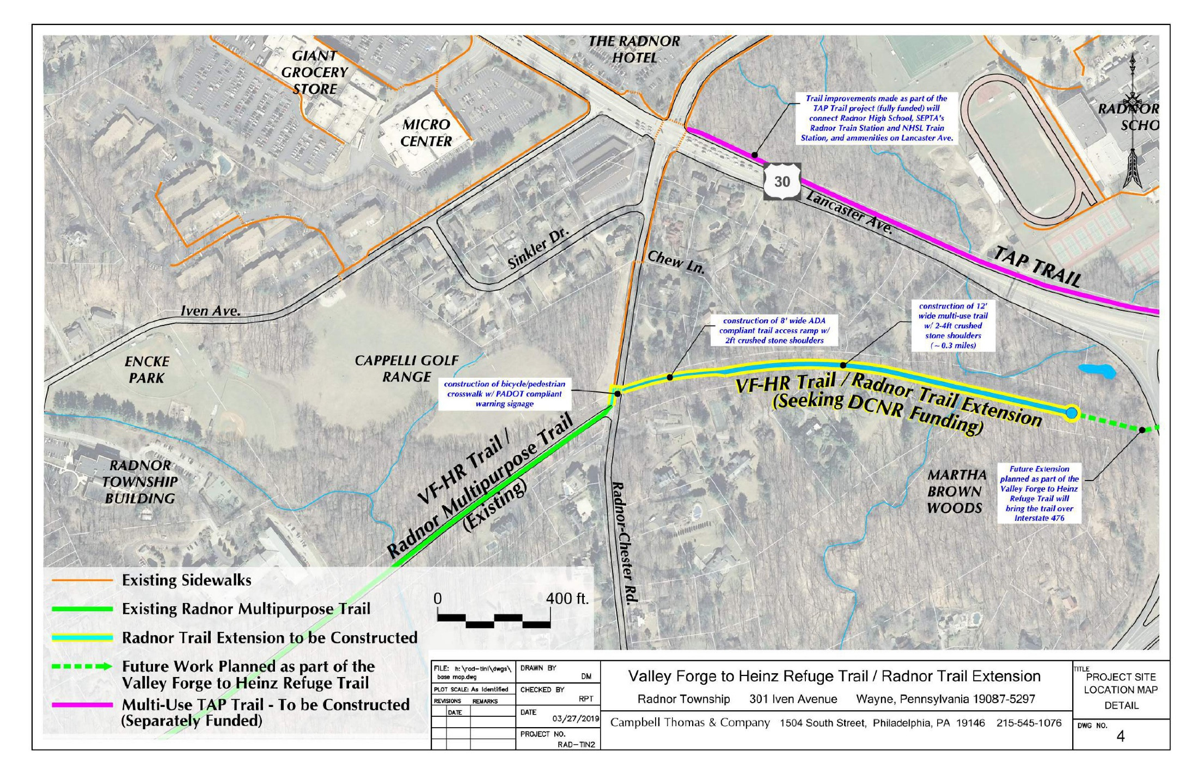
Project Location Map - 2

Slide 7
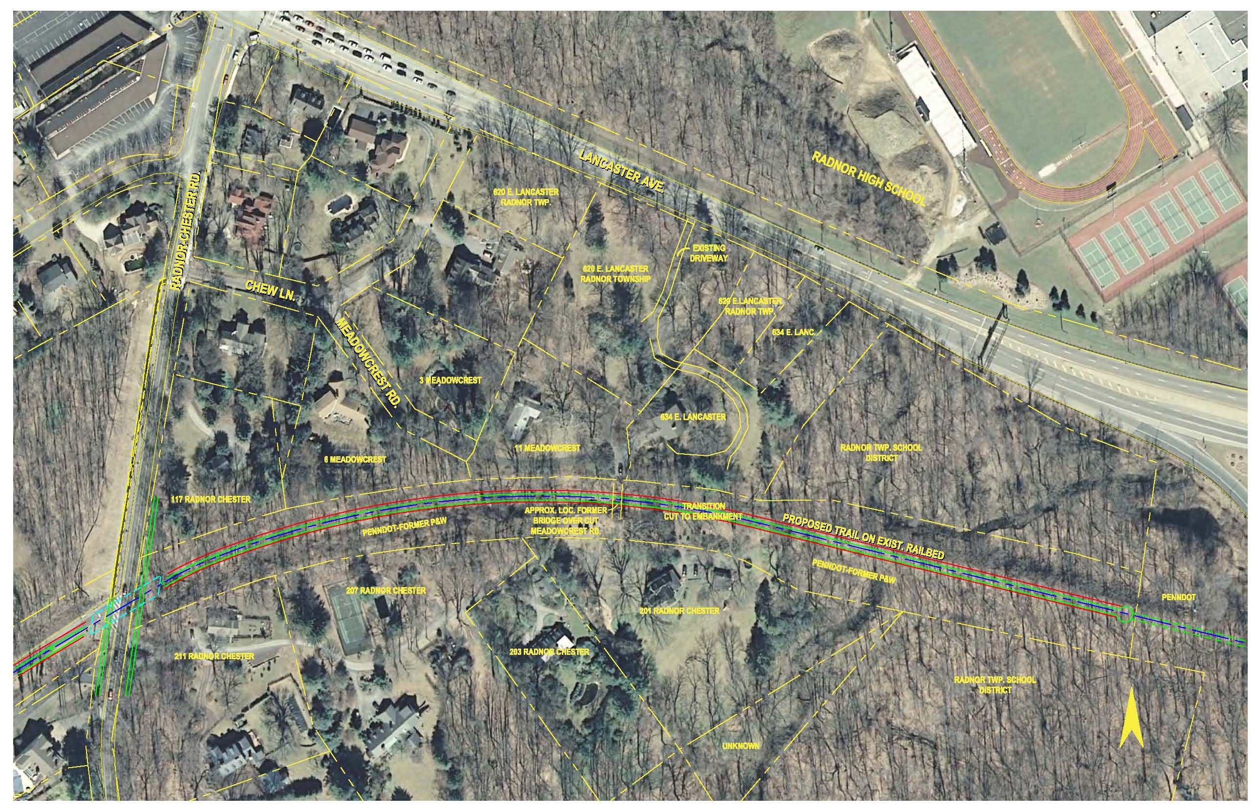
Parcel Map

Slide 8
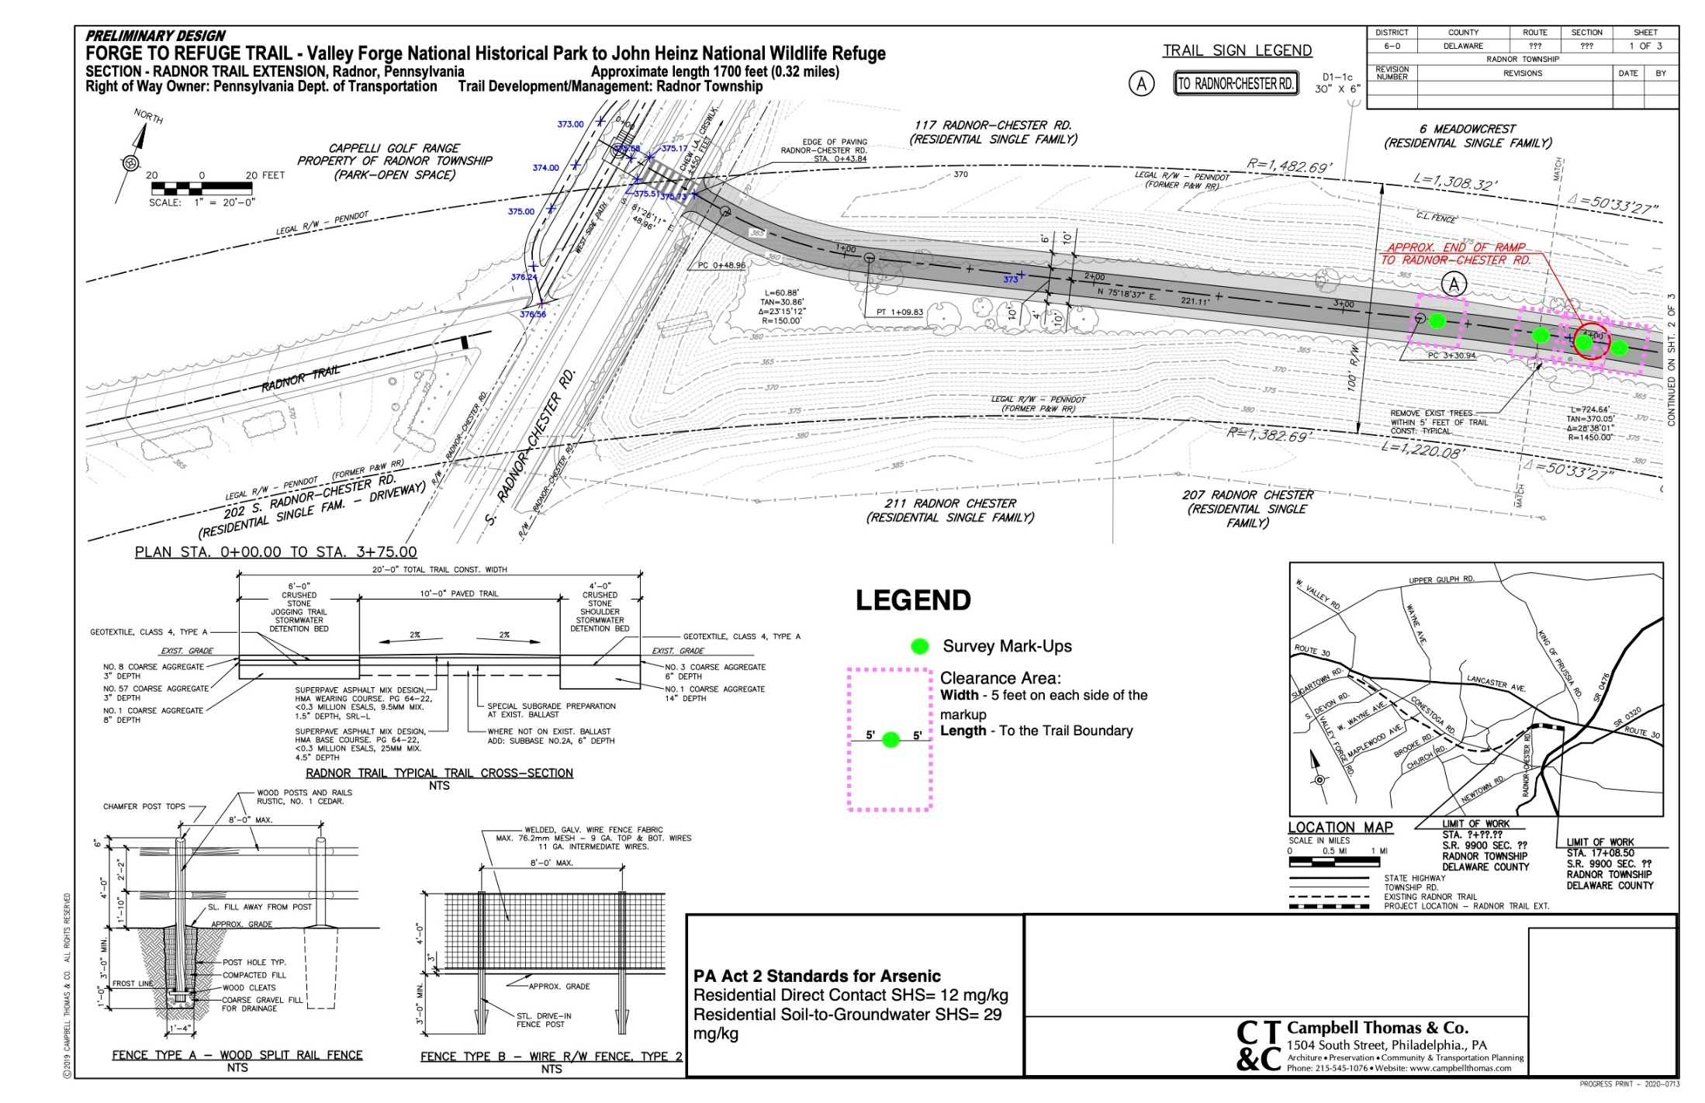
Updated Development Drawing - 1

Slide 9
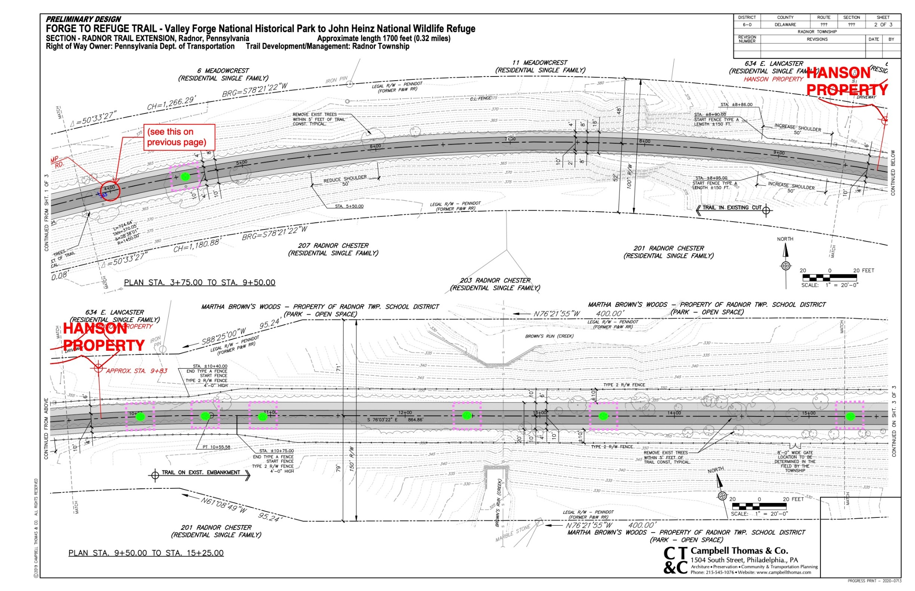
Updated Development Drawing - 2

Slide 10
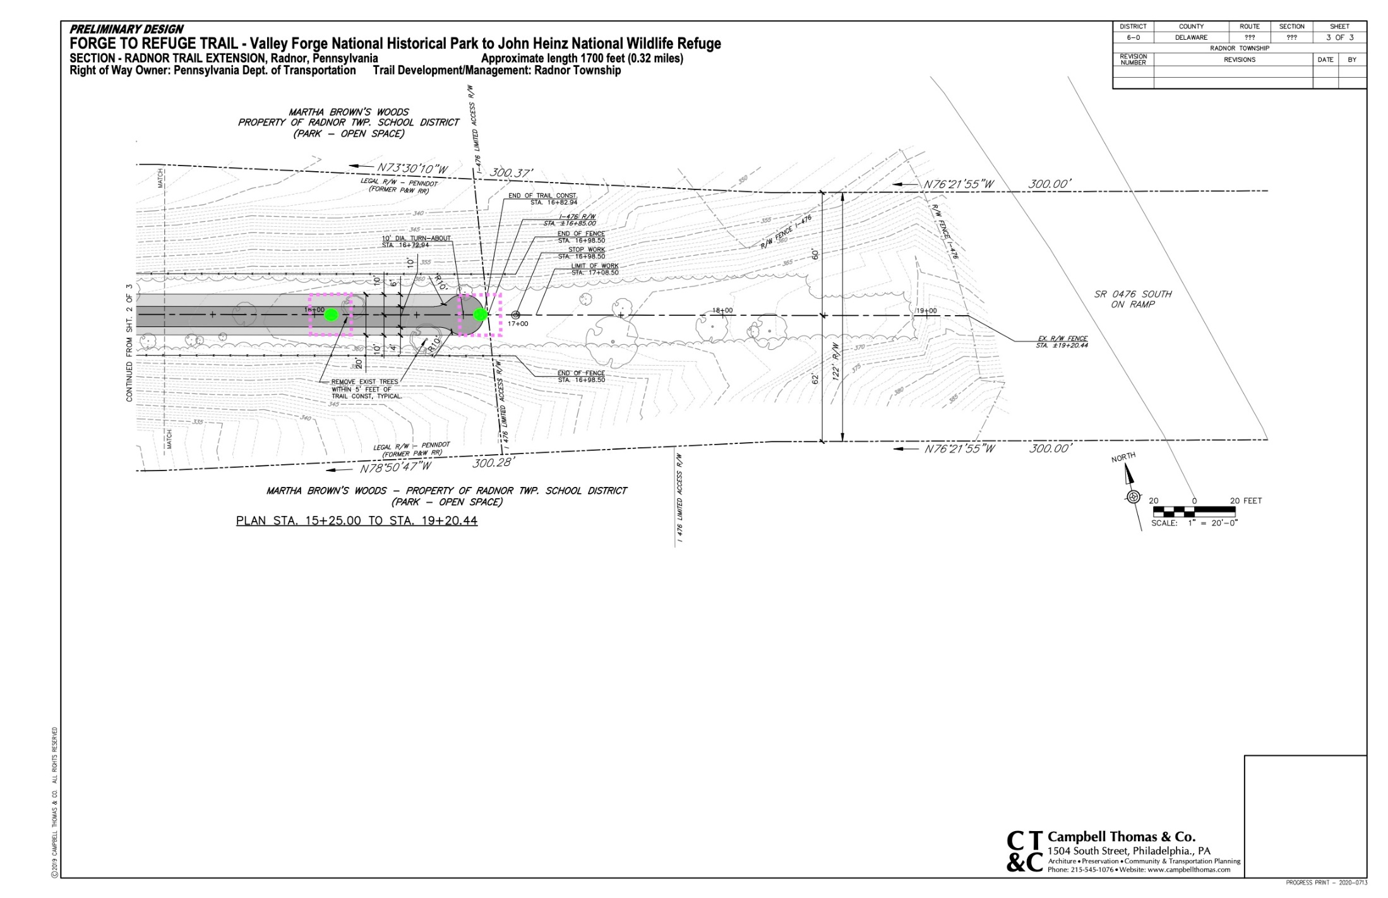
Updated Development Drawing - 3

Slide 11
Project Funding Status
DCED GTRP (2018)- $50,000 Received
15% Match Committed by Radnor Township
DCNR C2P2 (2019)- $232,000 Received
50% Total Match Required ($232,000):
$50,000 using DCED Funds
Additional $182,000 Committed by Radnor Township if needed
Delco Greenway Grant (2021)- $407,454 Received
No Match Required
May be used to match DCED and DCNR Grants

