Slide 1
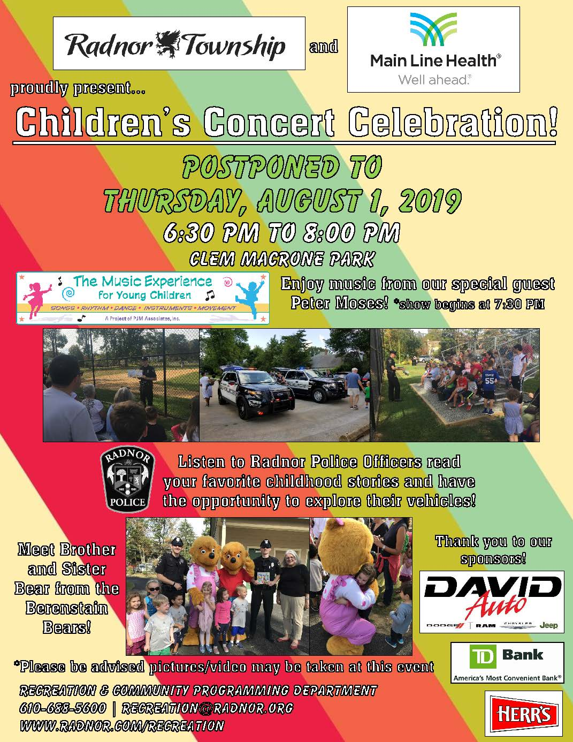

Slide 2
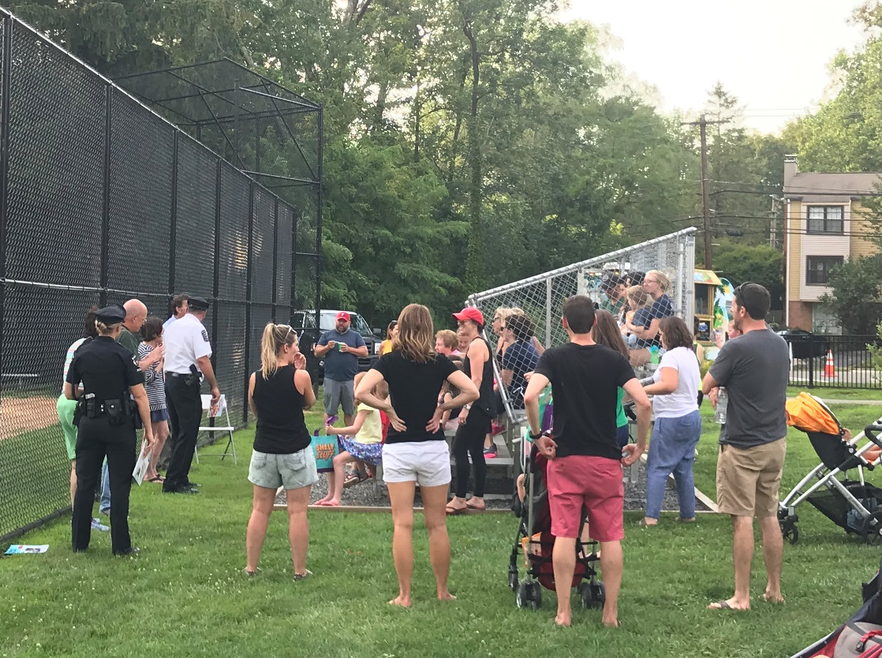
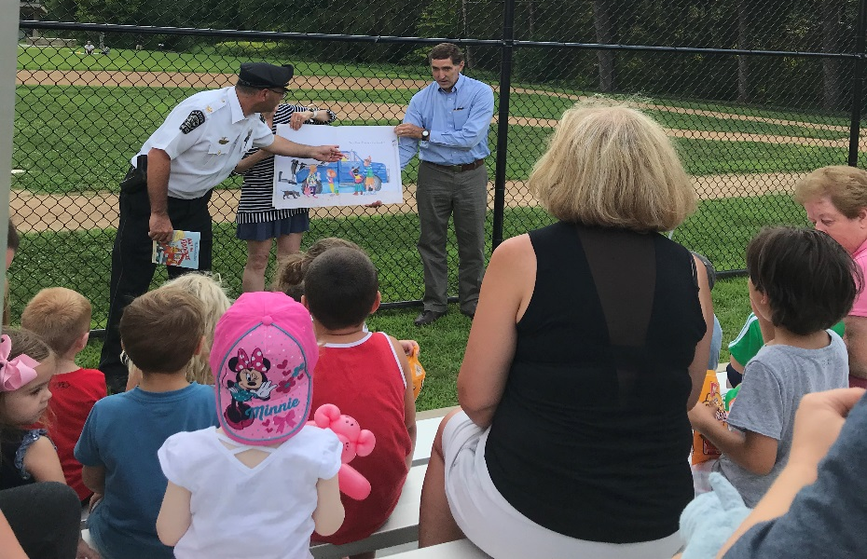
Over 300 people attended the children’s concert!
The evening began with story-time with the Radnor Police Department

Slide 3
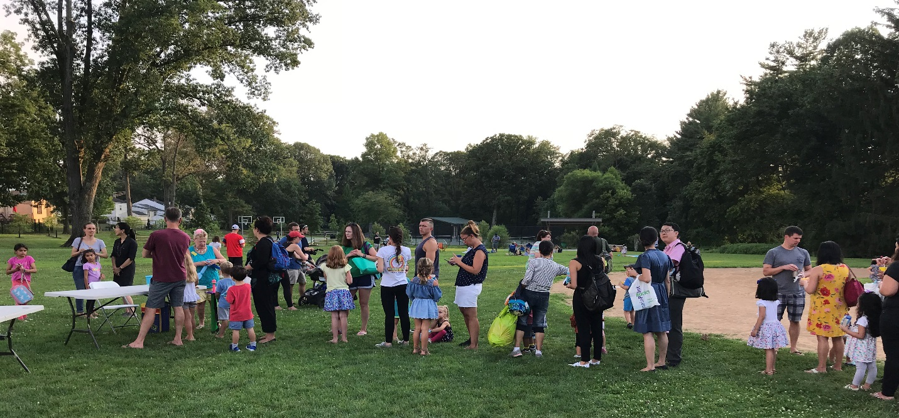
Afterwards, the children patiently waited on line for their free balloon animals!

Slide 4
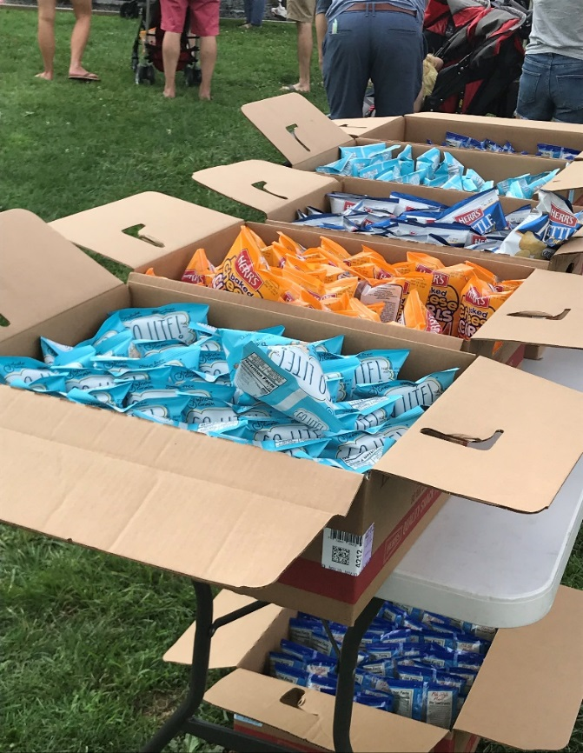
was onsite selling their delicious
water ices to concert-goers…
…Free snacks were made available
courtesy of Herr’s!
…and generously donated water!

Slide 5
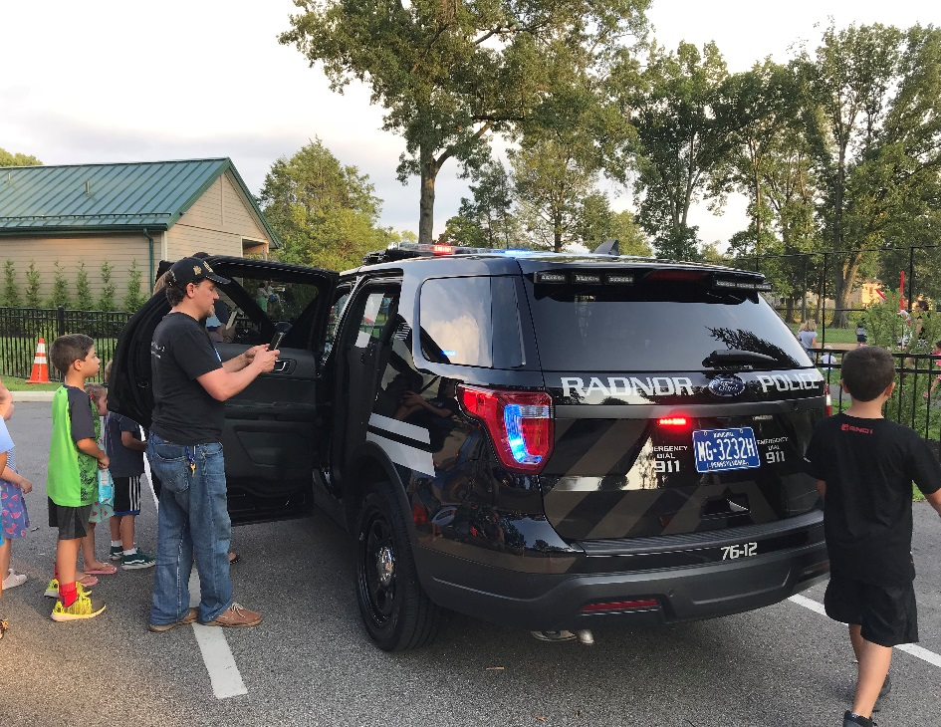
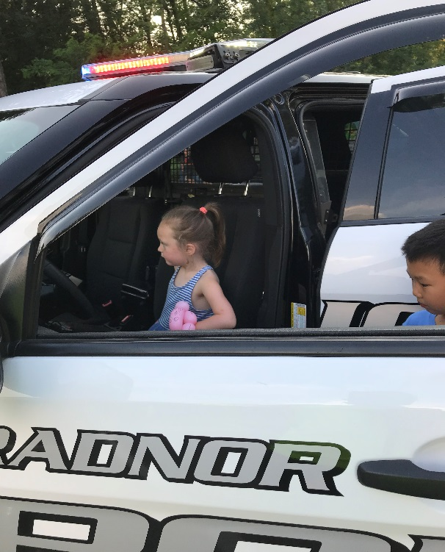
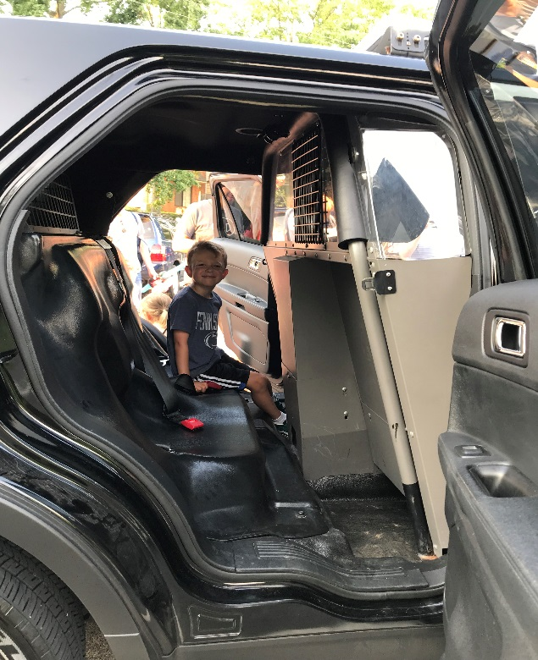
The children had a great time touring the police vehicles!

Slide 6
Summer-themed prize baskets were awarded to lucky winners of our free raffle!

Slide 7
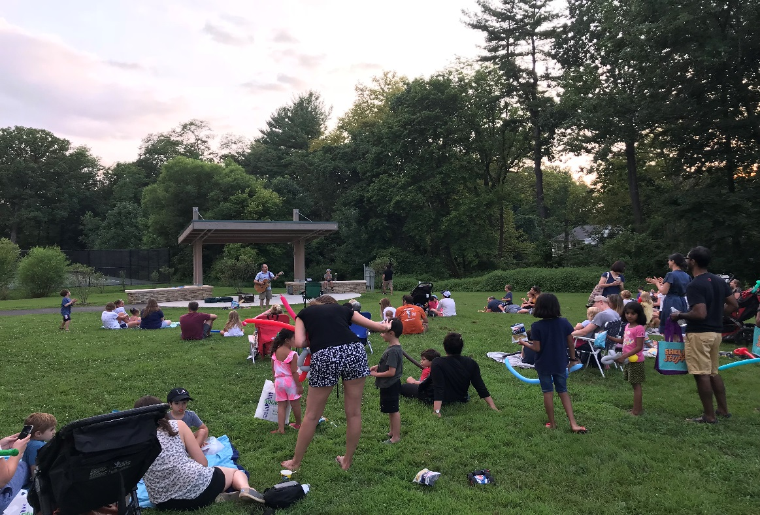
Families enjoyed the evening listening to the sounds of children’s musician, Peter Moses

Slide 8
Thank you to Main Line Health for being our presenting sponsor!

Slide 9
Thank you to all of our generous sponsors for making this event a huge success!

